Slide 1
Talent to Value Academy
Day 1 – New York City
March 2026

Slide 2





TALENT TO VALUE JOURNEY LEARNING OBJECTIVES
At the end of this program, participants will:
Know how to identify the big bets that drive disproportionate value
Be able to allocate stunningly good talent against the work that matters most
Understand how to mitigate risks and mobilize value to have a business impact
Review options for implementing a Talent to Value project and consider the best approach for their organization
Develop a high-level messaging and communications plan for speaking to critical stakeholders

Slide 3
AGENDA
Day 1
Day 2
TIME | TOPIC
AM | Welcome/Introductions T2V Overview Where to Allocate Stunningly Great Talent (/VALUE, /WORK)
LUNCH
PM | Stunningly Great Talent (/LIST) Beyond Talent (/CLICK)
- | DINNER & NETWORKING
TIME | TOPIC
AM | Reflections - Day 1 Value Creation (/MOBILIZE) T2V Project Implementation
LUNCH
PM | T2V Applications and Hands-On Work Taking it Back - Communications Certification Next Steps Close / Feedback

Slide 4




INTRODUCTIONS
Name, Role, Company
Exposure/Experience
with Talent to Value
Program Expectation
Fun Fact
Notes:
Name, Role, Company
Expectations for the Program
Exposure / Experience with Talent to Value
FUN Fact!

Slide 5




CEO SUCCESS
In Private Equity
In S&P500 Companies
WE LOOKED AT
80 Investments backward
100 Investments forward
6 Yrs
2x
4.8 Yrs
2.2
Years
56%
2013
2023
20% decline in
tenures*
CEO’s exited
in the first 2 years
2019 - 2024
Average time
to replacement
Failure Rate
80%
Transformations on the new curve within first 12-18 Months
*Equilar CEO Tenure Study
** Russell Reynolds Global CEO Turnover Index

Slide 6






THE CEO DILEMMA
Change the Top Team
Learn New Things
Change the Culture
“My Organization is not Talented Enough“

Slide 7


TALENT TO VALUE
From Talent in Roles
To Beyond Talent in Roles
Fast Start
Precision

Slide 8



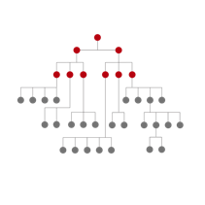
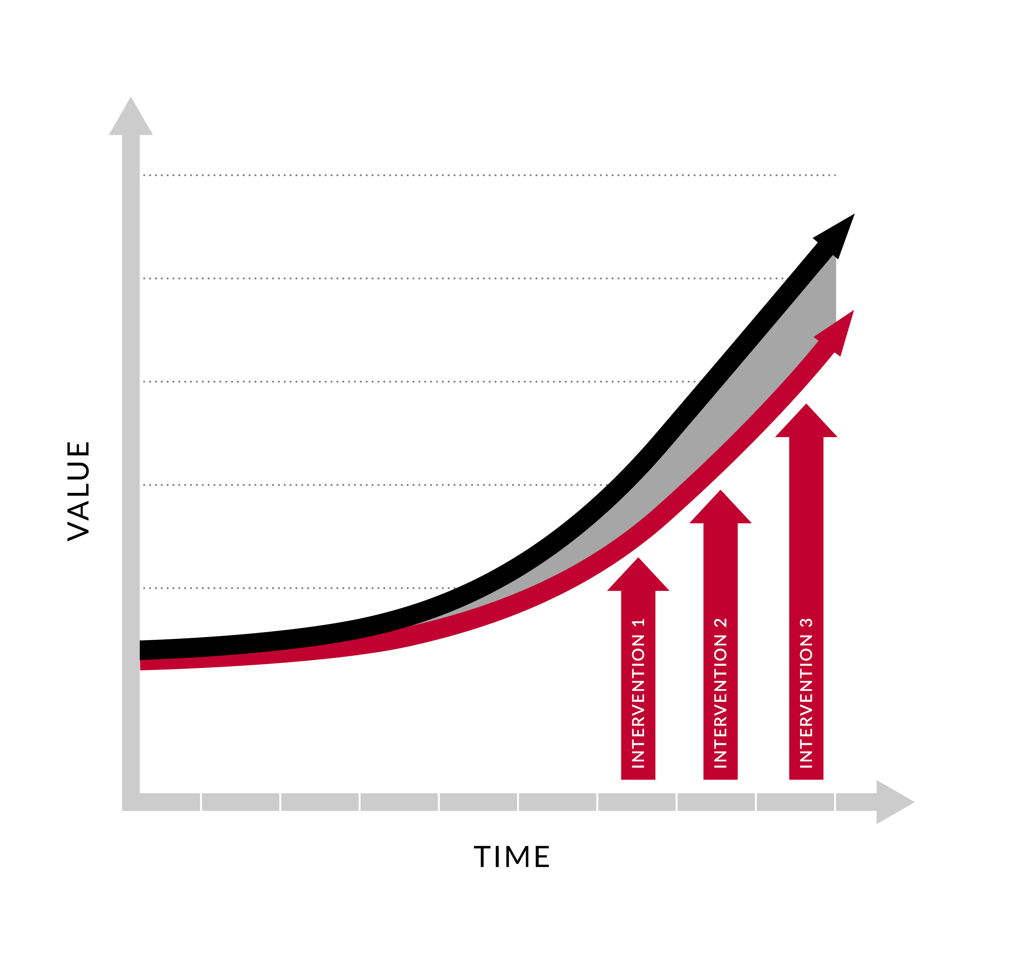
EVOLUTION OF TALENT TO VALUE
McKinsey + Private Equity
TOP 200 ROLES TOP 1000 TALENT
NON- HIERARCHICAL CRITICAL ROLES
100+ TRANSFORMATIONS
TALENT TO VALUE

Slide 9






How We See Ourselves
Specializes in strategy
Specializes in talent/HR
Macro Structure
Check In
Origin Story
Keynote Slides: Why T2V?
What is T2V: 5 Q’s
Shift 1: Break the Hierarchy
Shift 2: Beyond the Talent
Shift 3: To Value
CHRO Lens: Applications
Bringing T2V to Life
The world has mastered the bookends of transformation, but leaves the shift up to you

Slide 10
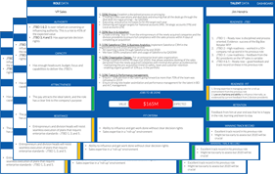
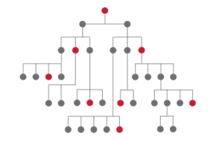

The “gearshifts” of Talent to Value
Macro Structure
Check In
Origin Story
Keynote Slides: Why T2V?
What is T2V: 5 Q’s
Shift 1: Break the Hierarchy
Shift 2: Beyond the Talent
Shift 3: To Value
CHRO Lens: Applications
Bringing T2V to Life
to VALUE
“From diagnostics to delivery”
Beyond the Talent
“70% of the execution risk”
Break the Hierarchy
“talented where it matters”

Slide 11
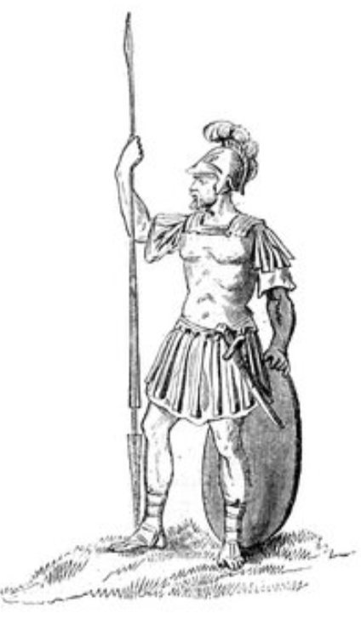

ONE METHODOLOGY
SIZED TO PURPOSE
$160B
150,000 Employees
2X Value
$49M
57 Employees
10X Value

Slide 12

OUR MISSION
ONE
MORE
THING

Slide 13
TALENT TO VALUE HELPS ANSWER….
01
Do you have the right leadership team?
02
Do you know the 20-30 critical roles across the organization that deliver 80% of value?
03
Do you have a minimally invasive plan to win?
04
Is the organization designed for success?
05
Is there enough capability to deliver the ambition?

Slide 14
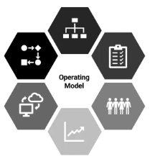
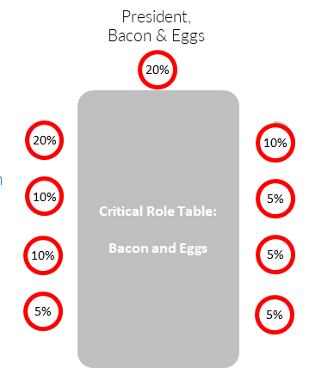
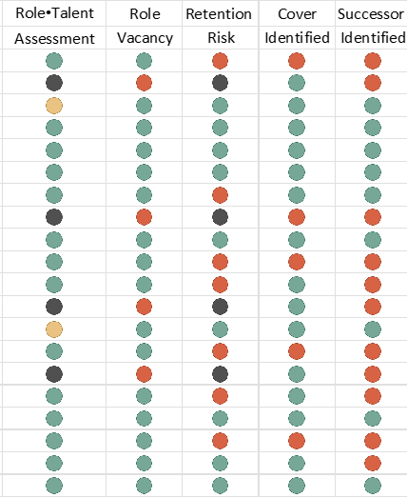
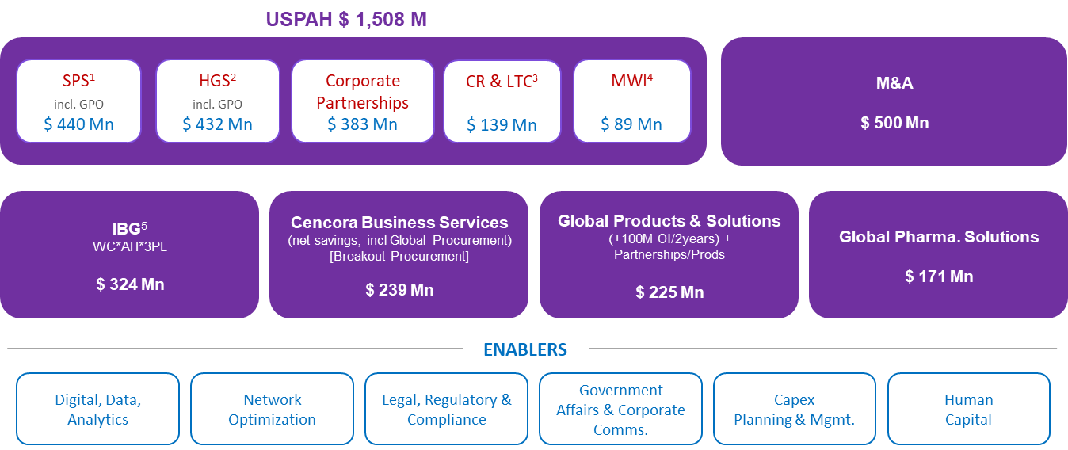

TALENT TO VALUE FROM CEO’S LENS
Where is the
money?
How do I want
to run the place?
Is my leadership team ready?
Do we have
enough talent
at our critical roles?
Are we
enabling success
at our critical roles?
Value Agenda
Operating Model
Top Team Mobilization
Talent Capital
Balance Sheet
Mobilize the Value

Slide 15
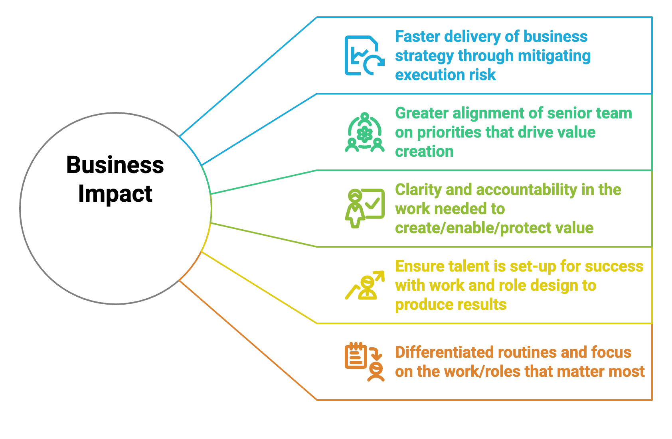

BUSINESS IMPACT OF TALENT TO VALUE

Slide 16




TALENT TO VALUE METHDOLOGY – AN OVERVIEW
Where is the money?
/VALUE
What needs to be true?
/WORK
What are the critical roles?
/LIST
Are we talented enough?
/CLICK
Shortest path to value?
/MOBILIZE
r
5-7 Critical bets that will “bend the curve”
Jobs to be Done that will deliver the value
25-50 roles deliver 80% of the value
Execution risk in
Role•Talent
Fewest initiatives
to deliver the value

Slide 17
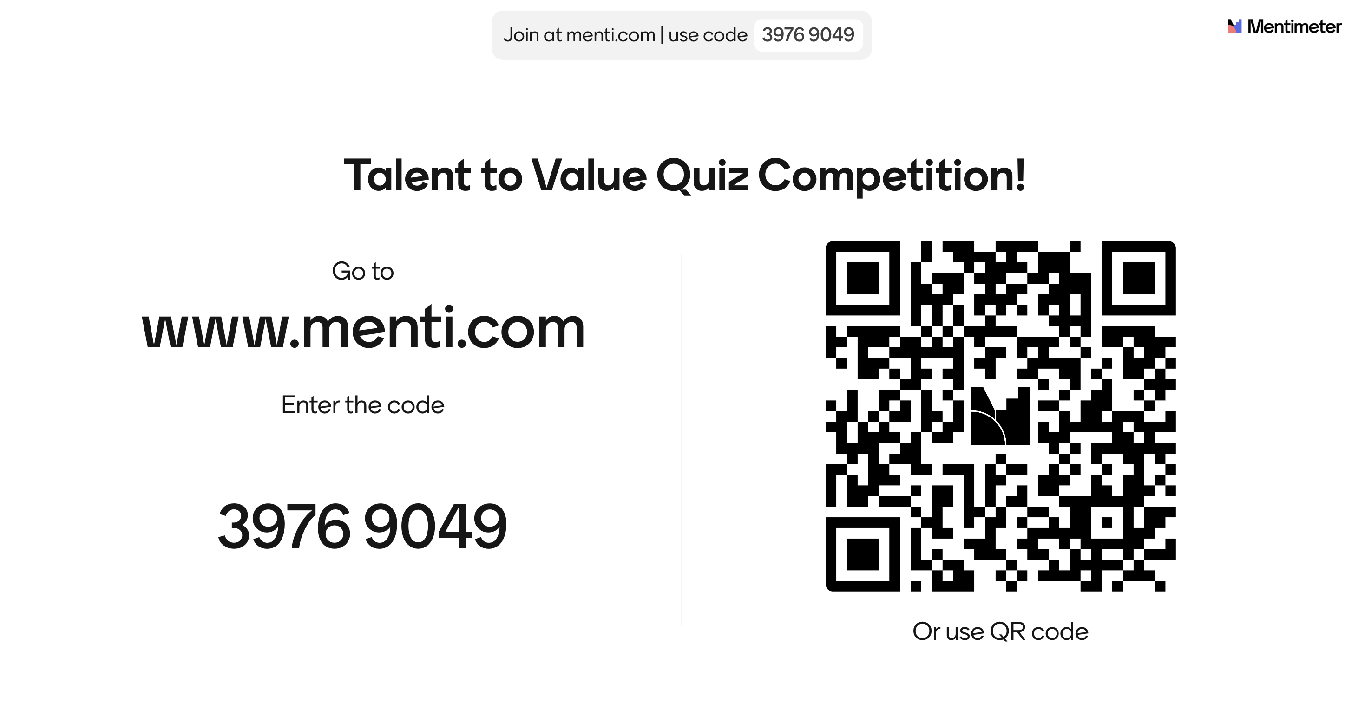

Slide 18
Break Time
15 Minutes
Go ahead and please stretch, move around, even run in place!

Slide 19
TALENT TO VALUE METHDOLOGY
Where is the money?
/VALUE
What needs to be true?
/WORK
What are the critical roles?
/LIST
Are we talented enough?
/CLICK
Shortest path to value?
/MOBILIZE
r
5-7 Critical bets that will “bend the curve”
Jobs to be Done that will deliver the value
25-50 roles deliver 80% of the value
Execution risk in
Role•Talent
Fewest initiatives
to deliver the value

Slide 20


UNDERSTAND THE VALUE
/ VALUE
/ WORK
/ LIST
/ CLICK
/ MOVE
Bend-The-Curve Case
Value Hotspots
Areas of the business where there is a material change in value creation (+ or -)
Occurs In Momentum Case or Bend-The-Curve Case
VALUE
Momentum Case
TIME

Slide 21
VALUE AGENDA
/ VALUE
/ WORK
/ LIST
/ CLICK
/ MOVE
$1
BN
Bend-The-Curve Case
Grow the Business
Strategic Pivots
Value Protection in High-Risk Areas
Value
$600
M
Momentum Case
Run the Business
Time

Slide 22

KEY CONCEPT | ANALYTICS + JUDGEMENT
/ VALUE
/ WORK
/ LIST
/ CLICK
/ MOVE
Geographies
Channels
Business Units
Consumer segments
Product segments
WHERE’S THE MONEY?
STRATEGIC
PIVOTS
FROM
TO
Examples
Notes:
There are so many possible hot spots – the rubics cube of value- really about the judgement piece- fewest steps to value- Moodys analytics- back of a napkin-

Slide 23


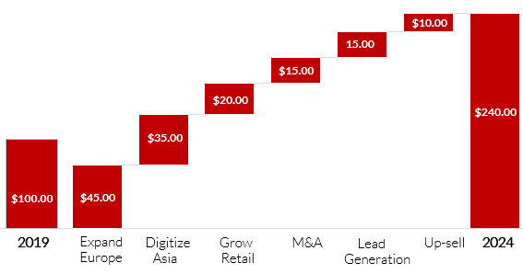
KEY CONCEPT | “FAT NUMBERS”
/ VALUE
/ WORK
/ LIST
/ CLICK
/ MOVE
CHOICES
VS.
CAPITAL
ALLOCATION
TALENT
ALLOCATION
“FAT” NUMBERS
“Nothing captures an imagination better… than a number!”
- Sumeet Salwan

Slide 24




EXAMPLE: IDENTIFYING VALUE HOTSPOTS
/ VALUE
/ WORK
/ LIST
/ CLICK
/ MOVE
A Leading global consumer health business
Portfolio of 50+ iconic and emerging brands
Focused on sustainable growth and innovation
The Client
DECLINING STOCK PRICE
& A NEW CEO
INORGANIC TO ORGANIC GROWTH
UNDER TALENTED ORGANIZATION

Slide 25
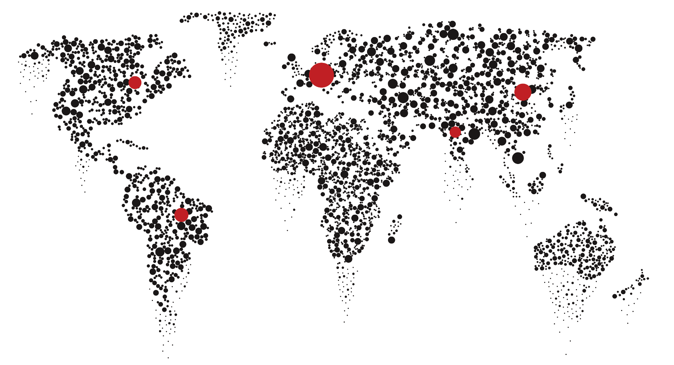
FACILITATING THE TREASURE HUNT
/ VALUE
/ WORK
/ LIST
/ CLICK
/ MOVE
Breakdown from finance team
Data Collection Templates
(product, region, BU, etc.)
Meeting with CFO with targeted questions to uncover hotspots
Strategy deck disseminated from client
Meeting with President and Ops to understand work, plans, etc.
CFO follow-up to clarify the curve-bending areas of work
Hypothesis on value hotspots and workshop with CEO

Slide 26
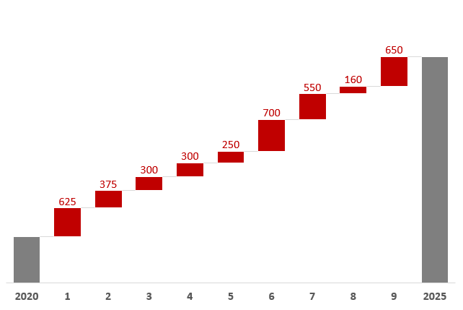
WHERE IS THE MONEY?
/ VALUE
/ WORK
/ LIST
/ CLICK
/ MOVE
Example 1
85% OF NET REVENUE ($ Mn.)
28000
24,000
INORGANIC TO
ORGANIC GROWTH
2025
Region X
VITAMINS
NA
HAIR
CARE
GROOMING
SKIN
CARE
DIGITAL
PRO-GO
DEV.
MKT
OTHER
2030
MARKETS
CATEGORY
NEW SPACES

Slide 27
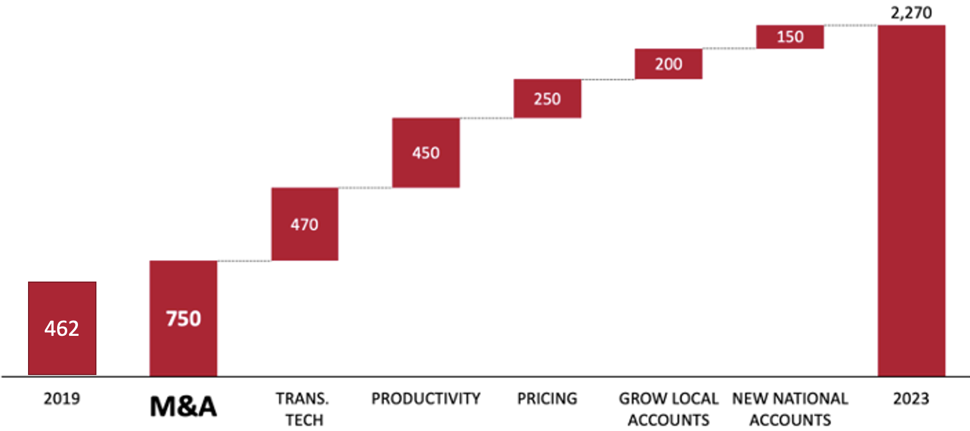
VALUE AGENDA: CASE EXAMPLE
/ VALUE
/ WORK
/ LIST
/ CLICK
/ MOVE
Example 2
National installer of commercial HVAC solutions
Fragmented market with +4000 sub-scale local outfits
Built 2025 – 2030 through roll-up. Now with new owner for Phase 2 roll-up
2025
2030
EBITDA $50M to $185M
ENTERPRISE VALUE From $462M to $2.2B

Slide 28

VALUE AGENDA | ACTIVITY
/ VALUE
/ WORK
/ LIST
/ CLICK
/ MOVE
1. Review the Strategic Business Case
- (10 mins)
2. Discuss and identify the Hotspots Comprising the Business Value Agenda
- (20 mins)
3. Group debrief / Q&A on how to approach in your organization - (15 mins)
https://qrco.de/bgeXPz

Slide 29

VALUE AGENDA | PLENARY CHECKLIST
/ VALUE
/ WORK
/ LIST
/ CLICK
/ MOVE
CHECK FOR: VALUE & STRATEGIC PIVOTS
5-7: NUMBER OF HOTSPOTS
70-80% OF THE VALUE COVERED
STRETCH & NEW WORK TO REACH THE ORGANIZATION'S AMBITION
ALIGNMENT CREATED BY THE VALUE AGENDA

Slide 30

TALENT TO VALUE METHDOLOGY
Where is the money?
/VALUE
What needs to be true?
/WORK
What are the critical roles?
/LIST
Are we talented enough?
/CLICK
Shortest path to value?
/MOBILIZE
r
5-7 Critical bets that will “bend the curve”
Jobs to be Done that will deliver the value
25-50 roles deliver 80% of the value
Execution risk in
Role•Talent
Fewest initiatives
to deliver the value

Slide 31

WORK CONTEXT & CRITICAL ROLES
/ VALUE
/ WORK
/ LIST
/ CLICK
/ MOVE
WHAT MUST BE ACCOMPLISHED?
HOW WILL IT BE DONE?
WHAT ARE THE KEY PIVOTS IN THE WORK?
BY WHEN?
Value Hotspots
DEFINING WORK CONTEXT @ HOTSPOTS IS CRITICAL

Slide 32
CREATE A TABLE FOR EACH HOTSPOT
/ VALUE
/ WORK
/ LIST
/ CLICK
/ MOVE
M&A
M&A
750M
EV $750
EBITDA $53

Slide 33
IDENTIFY THE WORK TO DELIVER THE VALUE
/ VALUE
/ WORK
/ LIST
/ CLICK
/ MOVE
M&A
M&A
750M
EV $750
EBITDA $53
IDENTIFY THE WORK
Double the deal volume from 3 to 6 deals p.a.
Build three-team approach
Outbound – Insource the team
Diligence & Deal Making
Integration & Synergy Extraction
Rigorous, repeatable processes for executing 2X deal volume

Slide 34
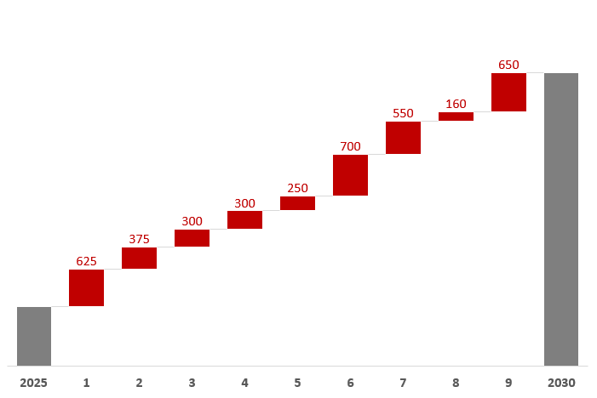
EXAMPLE: WHAT IS THE PIVOTAL WORK?
/ VALUE
/ WORK
/ LIST
/ CLICK
/ MOVE
85% OF NET REVENUE ($ Mn.)
28000
Jobs To Be Done for Hair Care
1
Turbocharge growth in emerging markets to 20-25% while maintaining momentum in NA and Europe
2
Expand global adjacencies from Hair Removal to Gel Products and Mousse
3
Expand from a SMB and Retail Only focus on building capabilities in Big-Box and Non-Commercial business
24,000
4
Build capabilities to support an Innovation-driven portfolio, that can be manufactured in smaller batches, with faster turns, and an agile supply chain.
2025
NA
2025
5
Scale with North American customers (e.g., WholeFoods) as they grow globally
2020
Region X
VITAMINS
HAIR
CARE
GROOMING
SKIN
CARE
DIGITAL
PRO-GO
DEV.
MKT
OTHER
2030
MARKETS
CATEGORY
NEW SPACES

Slide 35

WORK @ HOTSPOT | ACTIVITY
/ VALUE
/ WORK
/ LIST
/ CLICK
/ MOVE
1. Review the Hotspot
- (5 mins)
2. Discuss and identify 3-4 Critical Work Outcomes with Pivots @ the Hotspot
- (15 mins)
3. Group debrief / Q&A
- (10 mins)
https://qrco.de/bgeXQp

Slide 36
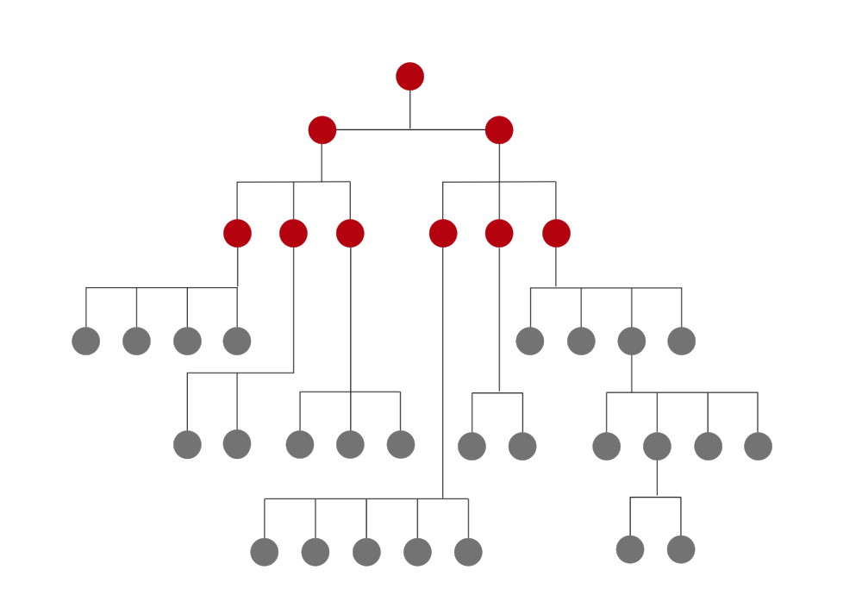
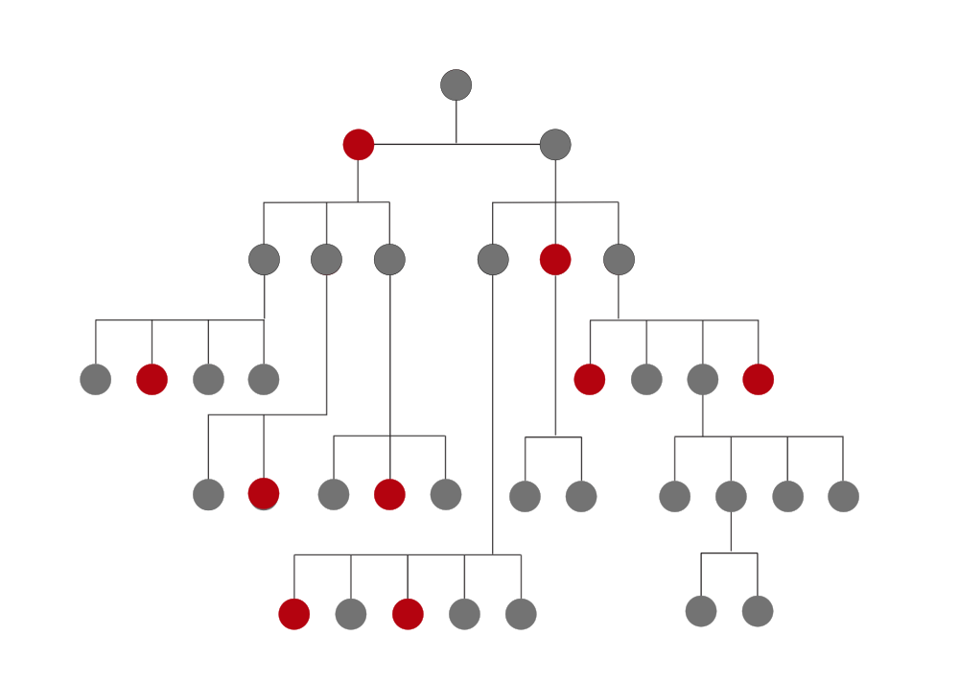




/LIST - IDENTIFY THE CRITICAL ROLES
/ VALUE
/ WORK
/ LIST
/ CLICK
/ MOVE
vs
TRADITIONAL APPROACH
Important roles are defined by their position in the hierarchy
Roles within the same level are equal
TALENT TO VALUE
Disproportionate impact on delivering the Critical work
Important roles are defined by their value contribution
Roles within the same level are not equal
THE LIST
VALUE HOTSPOTS
THE WORK
VALUE ROLES
VALUE RANKED ‘LIST’

Slide 37

/LIST - THE ROLES THAT DELIVER THE WORK
/ VALUE
/ WORK
/ LIST
/ CLICK
/ MOVE
VP M&A and Deal Execution
M&A
VP Sales & Marketing
M&A
750M
EV $750
CFO
EBITDA $53
IDENTIFY THE WORK
Double the deal volume from 3 to 6 deals p.a.
Build three-team approach
Outbound – Insource the team
Diligence & Deal Making
Integration & Synergy Extraction
Rigorous, repeatable processes for executing 2X deal volume
Head of Integration
Director of Outbound

Slide 38


/LIST - GOLDEN TRIANGLE LENS
/ VALUE
/ WORK
/ LIST
/ CLICK
/ MOVE
CEO PRIORITY LIST
VP M&A and Deal Execution
TOP DOWN
30%
VP Sales & Marketing
DISTILL THE LIST
CFO
Assign “CHIPS” to each role to allocate contribution to overall hotspot
M&A
750M
10%
10%
45 - 50
ROLES
80-90
ROLES
Head of Integration
Director of Outbound
BOTTOM UP
25%
25%
HOT SPOT OWNER LIST

Slide 39
EXAMPLE: WHAT ARE THE ROLES CRITICAL TO DELIVERING THE WORK?
/ VALUE
/ WORK
/ LIST
/ CLICK
/ MOVE
Jobs To Be Done for Hair Care
Reshape the Hair Care Table – Critical Roles
1
Turbocharge growth in emerging markets to 20-25% while maintaining momentum in NA and Europe
President, Intl Growth
20%
2
Expand global adjacencies from Hair Removal to Gel Products and Mousse
Critical Role Table:
Hair Care
Head of Global Hair Care Capabilities
NEW
20%
10%
VP Sales, Hair Care
3
Expand from a SMB and Retail Only focus on building capabilities in Big-Box and Non-Commercial business
VP Supplier Value
Creation
NEW
10%
5%
Head of Hair Care,
China
VP HC. Bus. Dev. NEW
10%
5%
Head of Hair Care,
Mexico
4
Build capabilities to support an Innovation-driven portfolio, that can be manufactured in smaller batches, with faster turns, and an agile supply chain.
VP Commercial, EU
NEW
5%
5%
Head of Hair Care,
Brazil
5
Scale with North American customers (e.g., WholeFoods) as they grow globally

Slide 40
/LIST INSIGHTS
/ VALUE
/ WORK
/ LIST
/ CLICK
/ MOVE
CRITICAL ROLE |  | ROLE VALUE
1 | VP M&A / Deal Execution | $472
2 | IT - Head of Transformative IT | $245
3 | HR - VP of Talent Acquisition | $162
4 | VP Sales | $154
5 | Head of Process Optimization | $149
6 | COO | $128
7 | Head of Pricing | $126
8 | Head of Integration | $113
9 | VP Sales - BD Enterprise Accounts | $112
10 | CIO | $93
11 | Head of Procurement | $65
12 | VP of Outbound | $63
13 | HR - Learning and Development | $58
14 | VP Sales - Account Management | $56
15 | VP Financial Planning & Analysis | $51
16 | CHRO | $44
17 | Division President – BU 1 | $37
18 | Division President – BU 2 | $37
19 | VP of Sales & Marketing | $35
3 | HR - VP of Talent Acquisition | $162
The LIST is derived from understanding the work and the responsible roles - it cannot be derived solely from an org chart
$220M OF VALUE UNDER THE CHRO
ROLES BY LEVEL
N-1 26% of roles
N-2 53% of roles
N-3 21 % of roles
5 NEW ROLES IDENTIFIED
13 | HR - Learning and Development | $58
16 | CHRO | $44

Slide 41
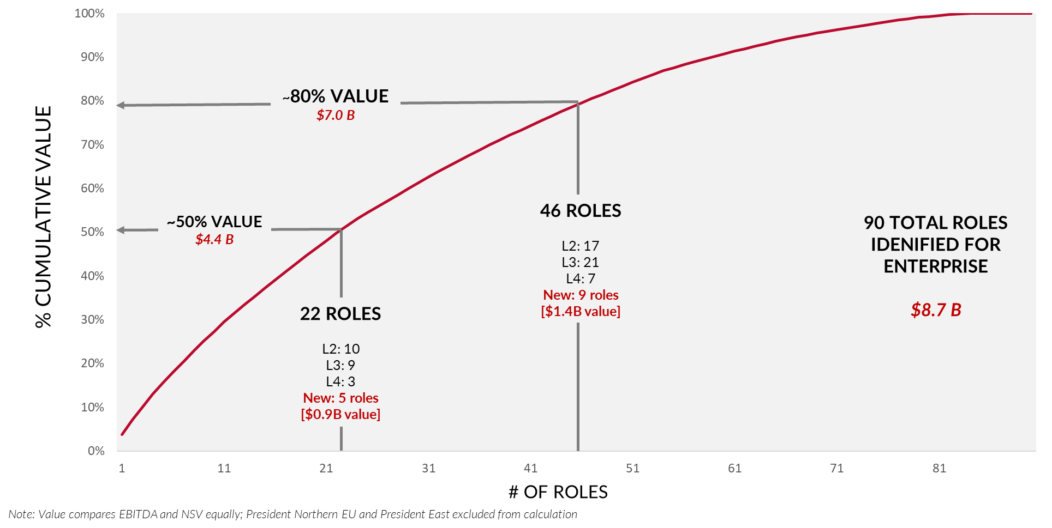
LIST OF CRITICAL ROLES IS RANK ORDERED
/ VALUE
/ WORK
/ LIST
/ CLICK
/ MOVE
Create a manageable, prioritized list of roles to deliver the 5-year strategy
The 46 Enterprise Critical Roles
# | Critical Role | Talent
1 | President, IGS | Peter Jackson
2 | President, US Growth | Liam Novak
3 | AVP WalWorld | Emma Fitzpatrick
4 | AVP of Strategic Accounts | Ethan Choi
5 | VP Marketing, Sauce | Vacant
6 | VP Global Supplier Value Creation | Olivia Larsson
7 | SVP Head of Operations, NA | Noah Patel
8 | VP Marketing, Snack | Vacant
9 | Head of M&A | Ava Rossi
10 | VP Sales, IGS US | Mason Nakamura
11 | Marketing Director, Platform 1 | Sophia Köhler
12 | VP Marketing, Meals | William Traoré
13 | Head of Revenue Management NA | Isabella Silva
14 | President, Bacon and Eggs | James Petrov
15 | Dimes Global Brand Lead | Benjamin Gupta
… | … | …
… | … | …
Point of Departure
On average 25 critical roles or less deliver ~50% of the value; 50 critical roles or less deliver 80% of the value

Slide 42
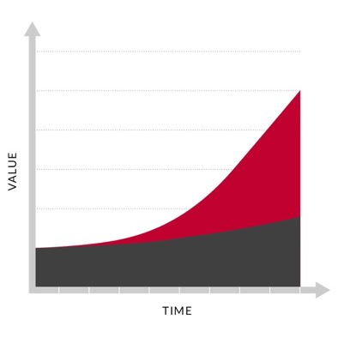
/LIST INSIGHTS - DUPLICATES & NEW ROLES
/ VALUE
/ WORK
/ LIST
/ CLICK
/ MOVE
RANK | CRITICAL ROLES | VALUE
1 | Head of Sales- Americas | £ 123.20
2 | Head of Data Strategy & Management | £ 116.00
3 | SVP, M&A | £ 96.80
4 | SVP, Growth & Innovation | £ 96.80
5 | Head of Sales- Europe | £ 91.20
6 | Chief Customer Officer | £ 88.00
7 | Head of Product Strategy | £ 84.00
8 | SVP, Market Intelligence & Foresight | £ 69.60
9 | MD, Head of Sales- Banking & Finance | £ 68.80
10 | Chief Product Officer | £ 58.40
11 | SVP Sales, Pensions & Endowments | £ 58.40
12 | Head of Strategic Relationships | £ 53.60
- | Head of Sales- Asia | £ 53.60
- | MD, Head of Customer Success- Americas | £ 39.20
- | MD, Head of Customer Success- Europe | £ 39.20
30 | CHRO | £ 15.20
ROLES IN MULTIPLE HOTSPOTS
“EXECUTION RISK”
NEW ROLES
“BEND THE CURVE”
4
3
3
15
Hotspots
Hotspots
Hotspots
Chief Customer Officer
Head of Sales- Europe
Head of Product Strategy
(23%)

Slide 43
/LIST INSIGHTS - STRATEGY IN ACTION
/ VALUE
/ WORK
/ LIST
/ CLICK
/ MOVE
Rank | Critical Role | Role Values
1 | Head of Sales- Americas | £ 123.20
2 | Head of Data Strategy & Management | £ 116.00
3 | SVP, M&A | £ 96.80
4 | SVP, Growth & Innovation | £ 96.80
5 | Head of Sales- Europe | £ 91.20
6 | Chief Customer Officer | £ 88.00
7 | Head of Product Strategy | £ 84.00
8 | SVP, Market Intelligence & Foresight | £ 69.60
9 | MD, Head of Sales- Banking & Finance | £ 68.80
10 | Chief Product Officer | £ 58.40
11 | SVP Sales, Pensions & Endowments | £ 58.40
12 | Head of Strategic Relationships | £ 53.60
13 | Head of Sales- Asia | £ 53.60
14 | MD, Head of Customer Success- Americas | £ 39.20
15 | MD, Head of Customer Success- Europe | £ 39.20
16 | Chief Enterprise Architect | £ 39.20
Rank | Critical Role | Role Values
17 | Chief Content Officer | £ 39.20
18 | CFO | £ 39.20
19 | GM, Sales- Asset Management | £ 39.20
20 | GM, Sales- Supra Sovereigns | £ 33.60
21 | Head of Data Science | £ 32.80
22 | Head of Talent Acquisition | £ 32.00
23 | Chief Portfolio Strategist | £ 29.60
24 | SVP, Integration- M&A | £ 28.80
25 | SVP, Head of Dev. Ops | £ 28.80
26 | SVP, Head of Data Ops | £ 27.20
27 | Head of Product Specialist/SME Sales | £ 20.80
28 | SVP, Pricing | £ 16.00
29 | Head of Content Partnerships | £ 15.20
30 | CHRO | £ 15.20
31 | SVP, Integration- Business Systems | £ 13.60
32 | SVP, Head of Operations | £ 13.60
Top 20 Roles
80% of Value
16 New Roles
50% of Value
22 Roles Cross-Platform
75% of Value

Slide 44
FROM WORK @ HOTSPOT TO CRITICAL ROLES
/ VALUE
/ WORK
/ LIST
/ CLICK
/ MOVE
Example
Accelerate Customer Growth
Customer Segmentation and Personalized Offerings: Tailor offerings to specific segments to improve profitability, retention, and reduce churn
Customer Growth in the existing and new market
CES Growth: Aiming for 20K annual customer growth. Continue to grow market share in new residential development and product expansion into CES.
Broadband Services Growth: Grow customer accounts from 150K to 500K+ through organic and strategic investments in broadband businesses or partnerships.
Invest in Lower Cost to Serve
Improve Cost-to-Serve Efficiency:
Unlock AI and automation opportunities
Optimize the cost-to-serve by embedding Hulk and Retail Z operating models to achieve a $100M reduction by FYXX
Reduce bad debts while maintaining compliance
Efficient labor arbitrage and labor cost reduction through AI
New Product Offerings / Innovations that expand Share of the Wallet
Identifying adjacencies or new product innovations that increase revenue and customer retention
Prioritizing and flawlessly executing new product introductions to existing and new customers
Customer Experience
Create outrageously great experiences for customers
Marketing and customer awareness of potential new products (bundling, special pricing)
General Manager Centralised Energy Services & New Property
Bundled Customer Solutions
$250M
Group Manager Retail Strategy & Pricing
General Manager, Broadband
4%
Chief Marketing Officer
Group Manager, Retail Technology & Digital
AI Analytics and Implementation
General Manager Legal & Compliance
Next-Gen Product Development
General Manager Finance & Commercial
General Manager, Operations
General Manager, Electrify and New Connections
Head of Credit and Collection
New Roles

Slide 45
REFINED CRITICAL ROLES
/ VALUE
/ WORK
/ LIST
/ CLICK
/ MOVE
Example
General Manager Centralised Energy Services & New Property
Bundled Customer Solutions
$250M
Group Manager Retail Strategy & Pricing
General Manager Centralised Energy Services & New Property
Bundled Customer Solutions
$250M
General Manager, Broadband
Chief Marketing Officer
Group Manager, Retail Strategy and Pricing
Group Manager, Retail Technology & Digital
AI Analytics and Implementation
General Manager, Broadband
General Manager, Operations
General Manager Legal & Compliance
Next-Gen Product Development
Head of Marketing, Retail
Next-Gen Product Development
General Manager Finance & Commercial
General Manager, Operations
Head of Credit and Collection
General Manager, Electrify and New Connections
Head of Credit and Collection

Slide 47




TALENT TO VALUE METHDOLOGY – AN OVERVIEW
Where is the money?
/VALUE
What needs to be true?
/WORK
What are the critical roles?
/LIST
Are we talented enough?
/CLICK
Shortest path to value?
/MOBILIZE
r
5-7 Critical bets that will “bend the curve”
Jobs to be Done that will deliver the value
25-50 roles deliver 80% of the value
Execution risk in
Role•Talent
Fewest initiatives
to deliver the value

Slide 48
TALENT TO VALUE: /CLICK
/ VALUE
/ WORK
/ LIST
/ CLICK
/ MOVE
Talent Score
Role Score
The “Click” describes the combination of the work, role and talent
Work Score
CLICK
ROLE
WORK
The Click assesses:
the degree of difficulty in the work
the design of the role to enable delivery
the talent match to the Jobs to Be Done
TALENT
Value is only driven if WORK, ROLE and TALENT are “in sync”

Slide 49


/CLICK CONNECTS WORK•ROLE•TALENT
/ VALUE
/ WORK
/ LIST
/ CLICK
/ MOVE
THE ROLE
THE WORK
THE TALENT
JOBS TO BE DONE (JTBD)
The three to five key actions and outcomes that must be delivered by the ROLE•TALENT combination
ROLE RISKS
Evidence collected on four role design features filtered through the lens of the Jobs to Be Done
TALENT RISKS
Evidence collected on four talent features filtered through the lens of the Jobs to Be Done
ROLE RISK Critical - Red and Amber
70%
30%
TALENT RISK Critical - Red and Amber

Slide 50


JOB DESCRIPTIONS vs JOBS TO BE DONE
/ VALUE
/ WORK
/ LIST
/ CLICK
/ MOVE
Job Descriptions
JOBS TO BE DONE
Describes Responsibilities
No Context
Actions and Outcomes
Linked to context and strategy

Slide 51



BUILDING JOBS TO BE DONE
/ VALUE
/ WORK
/ LIST
/ CLICK
/ MOVE
JOBS TO BE DONE
(JTBD)
OUTCOMES
KEY WORK
MEASURES
What
How
How Much &
By When
What are the 5-7 things that would
have to be true for the value to arrive?
What are the critical actions for each JTBD to answer, “Did it get done?”
What are the critical outcomes for each JTBD
to answer, “Did it get done well?”
When must the JTBD be achieved for
the value to arrive?

Slide 52
EXAMPLE: JOBS TO BE DONE
/ VALUE
/ WORK
/ LIST
/ CLICK
/ MOVE
WHAT
HOW
Create four additional mega brands through better therapeutic insights and product lifecycle management of ACME brands. Double the number of $50M+ brands by Q4 2026
HOW MUCH
BY WHEN

Slide 53

PRACTICE: JOBS TO BE DONE
/ VALUE
/ WORK
/ LIST
/ CLICK
/ MOVE
JOBS TO BE DONE
Develop Commercial organization (NAM & EMEA), increase productivity year over year per rep measured by quota attainment; build strong pipeline of opportunities; develop sales capability
Launch growth strategy initiatives
Increase new logos; generate $30M in 2026, $45M in 2027, $55M in 2028
Upsell existing accounts; generating annual ACV increase of 5%
Account retention (key accounts) net revenue retention of 98% in 2026 and 2027
Entry into utilities and re-enter IT vertical, generate revenues:
$700k in 2026, $2.9M in 2027, $5.2M in 2028, $7.5M in 2029
Grow market share in key verticals (Healthcare, Financial Services, & State Regulated) taking on PV and increase win rate against PV. Revenue generated:
$1.5M in 2026, $8.25M in 2027, $15.8M in 2028, $25.2M 2029
Close UKVI Row contract and implement partnership with XYZ. Measure % revenue achievement:
$0.2M in 2026, $1.5M in 2027, $2.0M in 2028, $2.0M in 2029
Provide your feedback on the given JTBD?

Slide 54
PRACTICE: JOBS TO BE DONE:
/ VALUE
/ WORK
/ LIST
/ CLICK
/ MOVE
JOBS TO BE DONE
Develop Commercial organization (NAM & EMEA), increase productivity year over year per rep measured by quota attainment; build strong pipeline of opportunities; develop sales capability
Launch growth strategy initiatives
Increase new logos; generate $30M in 2026, $45M in 2027, $55M in 2028
Upsell existing accounts; generating annual ACV increase of 5%
Account retention (key accounts) net revenue retention of 98% in 2026 and 2027
Entry into utilities and re-enter IT vertical, generate revenues:
$700k in 2026, $2.9M in 2027, $5.2M in 2028, $7.5M in 2029
Grow market share in key verticals (Healthcare, Financial Services, & State Regulated) taking on PV and increase win rate against PV. Revenue generated:
$1.5M in 2026, $8.25M in 2027, $15.8M in 2028, $25.2M 2029
Close UKVI Row contract and implement partnership with XYZ. Measure % revenue achievement:
$0.2M in 2026, $1.5M in 2027, $2.0M in 2028, $2.0M in 2029
Launch growth strategy initiatives:
Penetrate in Japan and Brazil with 5 new logos, generating $30M in 2026, $45M in 2027 & $55M in 2028
Generate an annual ACV increase of 5% by Q1 2027 for existing federal government accounts by increasing Scrum enrollment by 25% and PMP enrollment by 40%
Notes:
Add

Slide 55


55
ACTIVITY: QUALITY JOBS TO BE DONE
/ VALUE
/ WORK
/ LIST
/ CLICK
/ MOVE
Investigate new therapeutic uses for ABC drug based on clinical data and secure expanded approvals/new uses for ABC drug through U.S. FDA within 36 months of product launch
Expand into new verticals to move from a restaurant brand to an “everywhere” brand
Outcome: From 75% restaurant business today to 50/50 split in 3 years, and 25% Quick Service Restaurant / 75% Free Standing Restaurant/Non-Commerical in 10 years
Expand from a QSR only focus to build capabilities in FSR and Non-Commercial business (e.g. Aramark, Sodexo, Hospitals, Universities, Military
3. Double Emerging Markets (EM) sales and profitability within the next 3 years through organic growth
4. Staff & deploy three internal M&A teams (Deal, Integration, Outbound) used to close and assimilate new companies into consistent processes/structure
5. Increase existing customers share-of-wallet through selling add-on services in insurance, broadband and other innovative products starting in Q2-202X

Slide 56

/CLICK | JOBS TO BE DONE ACTIVITY
/ VALUE
/ WORK
/ LIST
/ CLICK
/ MOVE
Reflect on your role/value you will deliver over the next 3 years
(10 mins)
2. Define 5-7 specific JTBD statements that will deliver this value
(15 mins)
3. Pair up with a partner and share one of your JTBDs; the Partner will listen & provide feedback on the JTBD against the elements for a well-written statement
(10 mins)
Look for What? How? How Much? and By When?
www.ceoworks.com/jtbd-helper
4. Group debrief and sharing of a few examples
(10 mins)

Slide 57
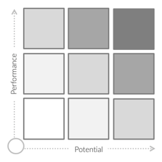
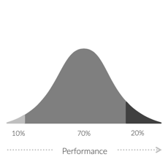

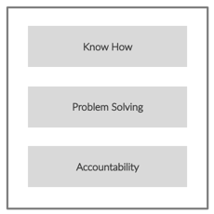
THE ‘CURRENT’ HUMAN RESOURCES TOOLS
9-Box Performance Management
Performance Bell Curve
Employee Engagement
Job Evaluation
RAPID REDEPLOYMENT OF
HUMAN CAPITAL
Appeared in the 1970s with unknown origin.
Pioneered by Jack Welch in the 1980s at General Electric.
Appeared in the 1950s at Esso Research and Engineering Company.
Appeared in the 1880s in the US Civil Service Commission. Written into law in Equal Pay Act 1963.

Slide 58
CLICK VALUE ASSESSMENT AT WORK, ROLE & TALENT
/ VALUE
/ WORK
/ LIST
/ CLICK
/ MOVE
Talent Score
Role Score
Work Score
WORK CHALLENGE
ROLE DESIGN
TALENT MATCH
CLICK
Outcome Alignment
Authority
JTBD Match
Execution Complexity
Capacity
Superpowers Match
New Work
Resistance
Winning Track Record
Competitive Intensity
Incentives
Two-Way Fit

Slide 59

CLICK – WORK
/ VALUE
/ WORK
/ LIST
/ CLICK
/ MOVE
Risks to the deliver the work, linked to the Jobs to be Done…
Alignment: Is there alignment across stakeholders on the JTBDs?
Work Score
Complexity: Is this an exceptionally complex task to deliver?
New Work: Is the work new to the role, team, or organization?
Competitive Intensity: Is there significant external competitive pressure that impacts delivery?

Slide 60
CLICK – ROLE
/ VALUE
/ WORK
/ LIST
/ CLICK
/ MOVE
Risks to the design of the Role, linked to the Jobs to be Done…
Authority: Does the role have appropriate decision rights to deliver the JTBDs?
Role Score
Capacity: Are there adequate resources / team capabilities to deliver the JTBDs?
Resistance: Does the role face any internal or external resistance to deliver the JTBDs?
Incentives: Are the incentives appropriately aligned to the scope of the work expected to deliver?

Slide 61


SUPERPOWERS
/ VALUE
/ WORK
/ LIST
/ CLICK
/ MOVE
Superpowers needed to:
Execute the Jobs to Be Done
Mitigate the Work & Role Risks
GENERIC FIT CRITERIA
SUPERPOWERS

Slide 62
SUPERPOWERS
/ VALUE
/ WORK
/ LIST
/ CLICK
/ MOVE
Can you recruit against it?
Collaboration with edge
Proven Ability to drive projects with pace in an environment where people are not fully aligned + “want” to work with this leader
Strong collaboration orientation
Notes:
After 28 create breakout … Jobs to be done + use the interview guide that has been sent

Slide 63
CLICK – TALENT
/ VALUE
/ WORK
/ LIST
/ CLICK
/ MOVE
Is the current talent in the role fit to deliver the value linked to the role through the Jobs To Be Done?...
JTBD Match: Is there a strong match of skills and experiences to do the JTBDs?
Talent Score
Superpower Match: How well matched is the talent to the
identified superpowers?
Winning Track Record: Does the person have a consistent track record of persisting and finding a way to win?
Two-Way Fit: Is there alignment between the individual and org culture, operating environment?

Slide 64
/CLICK | ROLE-TALENT CARD
/ VALUE
/ WORK
/ LIST
/ CLICK
/ MOVE
What insights or observations stand out to you in the following example?
2. Where would you focus to have the QUICKEST and most SIGNIFICANT impact?

Slide 65
VP Sales
Jimmy Hendrix
Expected Value: $165M
/CLICK | ROLE-TALENT CARD
Work
Role
Jobs to Be Done
1. (35%) Pricing: Establish a disciplined process on pricing by: Creating a sales operations and deal desk and ensuring that all the deals go through the deal desk (no rogue pricing) – by QX20XX Executing annual price increases to hit X% target each year Delivering sell margin targets for National accounts (X%) , Strategic accounts (Y%) and Local accounts (Z%) 2. (30%) Buy-in & Adoption: Create a strong “ buy-in” from the entrepreneurs of the newly acquired companies and the division presidents to ensure full compliance with the sales process within X days of completing an acquisition 3. (15%) Salesforce CRM & Business Analytics: Implement Salesforce CRM in the organization by end 2027 and ensure that: All reporting is done through Salesforce by end 2027 We have 100% compliance with and usage of Salesforce by QX20XX 4. (10%) Organization Design: For an enterprise level sales organization: Design a platform within 90 days (Q2 2027) that allows seamless docking of the sales personnel from the newly acquired companies with minimal disruption as evidenced by: - maintaining the pre-acquisition trend on safety, team and customer retention - enabling organic growth of 10% p.a. in the portfolio 5. (10%) Talent & Performance management: Ensure < 10% attrition in BD talent going forward as more than 70% of the team was refreshed in 2025 Ensure strong new leader assimilation and performance management for the talent in BD and A/C management
Alignment
Lack of alignment across Presidents on pricing standardization needs
Authority
JTBD 1 & 2: Is over reliant on convening or influencing authority. This is a risk to 65% of the expected value
JTBD 3, 4 and 5: Has appropriate decision rights
Complexity
Lack of enterprise-wide CRM introduces level of complexity in execution
Capacity
Has enough headcount, budget, focus and capabilities to deliver the JTBD’s
Resistance
Entrepreneurs and division heads will resist seamless execution of plans that require enterprise standards - JTBD 1, 3, and 5.
New Work
Never been done across the enterprise
Talent Score
Role Score
Incentives
The pay attracts the ideal talent, and the role has a clear link to the company’s purpose
Work Score
Competitiveness
No outside influence
CLICK
JTBD Match
1. JTBD 1 – Ready now: is disciplined and process oriented. Evidence : success of the Big Box Retailer RFP.
Superpowers
1. Strong expertise in managing sales for a roll up environment from the previous role
2. Low on charisma and ability to influence internally, as evidenced by current feedback from 2 division presidents
2. JTBD 2 - High readiness – worked in a 50+ company roll up world in his previous role
3. JTBD 3 – Low readiness – feedback from the BU presidents on the VP sales is variable
4. JTBD 4 & 5 – Ready now – good feedback and track record on these in his previous role
Winning Track Record
He had an excellent track record in his previous role
# | Superpowers
1 | Ability to influence and get work done without clear decision rights
2 | Sales expertise in a “roll-up” environment
Two Way Fit
Feedback from him at year end was that he is happy in the role, learning and keen to stay
Talent

Slide 66
VP Sales
Jimmy Hendrix
Expected Value: $165M
/CLICK | ROLE-TALENT CARD
Work
Role
Jobs to Be Done
1. (35%) Pricing: Establish a disciplined process on pricing by: Creating a sales operations and deal desk and ensuring that all the deals go through the deal desk (no rogue pricing) – by QX20XX Executing annual price increases to hit X% target each year Delivering sell margin targets for National accounts (X%) , Strategic accounts (Y%) and Local accounts (Z%) 2. (30%) Buy-in & Adoption: Create a strong “ buy-in” from the entrepreneurs of the newly acquired companies and the division presidents to ensure full compliance with the sales process within X days of completing an acquisition 3. (15%) Salesforce CRM & Business Analytics: Implement Salesforce CRM in the organization by end 2027 and ensure that: All reporting is done through Salesforce by end 2027 We have 100% compliance with and usage of Salesforce by QX20XX 4. (10%) Organization Design: For an enterprise level sales organization: Design a platform within 90 days (Q2 2027) that allows seamless docking of the sales personnel from the newly acquired companies with minimal disruption as evidenced by: - maintaining the pre-acquisition trend on safety, team and customer retention - enabling organic growth of 10% p.a. in the portfolio 5. (10%) Talent & Performance management: Ensure < 10% attrition in BD talent going forward as more than 70% of the team was refreshed in 2025 Ensure strong new leader assimilation and performance management for the talent in BD and A/C management
Alignment
Lack of alignment across Presidents on pricing standardization needs
Authority
JTBD 1 & 2: Is over reliant on convening or influencing authority. This is a risk to 65% of the expected value
JTBD 3, 4 and 5: Has appropriate decision rights
Complexity
Lack of enterprise-wide CRM introduces level of complexity in execution
Capacity
Has enough headcount, budget, focus and capabilities to deliver the JTBD’s
Resistance
Entrepreneurs and division heads will resist seamless execution of plans that require enterprise standards - JTBD 1, 3, and 5.
New Work
Never been done across the enterprise
Talent Score
Role Score
Incentives
The pay attracts the ideal talent, and the role has a clear link to the company’s purpose
Work Score
Competitiveness
No outside influence
CLICK
JTBD Match
1. JTBD 1 – Ready now: is disciplined and process oriented. Evidence : success of the Big Box Retailer RFP.
Superpowers
1. Strong expertise in managing sales for a roll up environment from the previous role
2. Low on charisma and ability to influence internally, as evidenced by current feedback from 2 division presidents
2. JTBD 2 - High readiness – worked in a 50+ company roll up world in his previous role
3. JTBD 3 – Low readiness – feedback from the BU presidents on the VP sales is variable
4. JTBD 4 & 5 – Ready now – good feedback and track record on these in his previous role
Winning Track Record
He had an excellent track record in his previous role
# | Superpowers
1 | Ability to influence and get work done without clear decision rights
2 | Sales expertise in a “roll-up” environment
Two Way Fit
Feedback from him at year end was that he is happy in the role, learning and keen to stay
Talent
Talent

Slide 67
VP Sales
Jimmy Hendrix
Expected Value: $165M
/CLICK | ROLE-TALENT CARD
Work
Role
Jobs to Be Done
1. (35%) Pricing: Establish a disciplined process on pricing by: Creating a sales operations and deal desk and ensuring that all the deals go through the deal desk (no rogue pricing) – by QX20XX Executing annual price increases to hit X% target each year Delivering sell margin targets for National accounts (X%) , Strategic accounts (Y%) and Local accounts (Z%) 2. (30%) Buy-in & Adoption: Create a strong “ buy-in” from the entrepreneurs of the newly acquired companies and the division presidents to ensure full compliance with the sales process within X days of completing an acquisition 3. (15%) Salesforce CRM & Business Analytics: Implement Salesforce CRM in the organization by end 2027 and ensure that: All reporting is done through Salesforce by end 2027 We have 100% compliance with and usage of Salesforce by QX20XX 4. (10%) Organization Design: For an enterprise level sales organization: Design a platform within 90 days (Q2 2027) that allows seamless docking of the sales personnel from the newly acquired companies with minimal disruption as evidenced by: - maintaining the pre-acquisition trend on safety, team and customer retention - enabling organic growth of 10% p.a. in the portfolio 5. (10%) Talent & Performance management: Ensure < 10% attrition in BD talent going forward as more than 70% of the team was refreshed in 2025 Ensure strong new leader assimilation and performance management for the talent in BD and A/C management
Alignment
Lack of alignment across Presidents on pricing standardization needs
Authority
JTBD 1 & 2: Is over reliant on convening or influencing authority. This is a risk to 65% of the expected value
JTBD 3, 4 and 5: Has appropriate decision rights
Complexity
Lack of enterprise-wide CRM introduces level of complexity in execution
Capacity
Has enough headcount, budget, focus and capabilities to deliver the JTBD’s
Resistance
Entrepreneurs and division heads will resist seamless execution of plans that require enterprise standards - JTBD 1, 3, and 5.
New Work
Never been done across the enterprise
Talent Score
Talent Score
Role Score
Incentives
The pay attracts the ideal talent, and the role has a clear link to the company’s purpose
Role Score
Work Score
Work Score
Competitiveness
No outside influence
CLICK
CLICK
Superpowers
1. Strong expertise in managing sales for a roll up environment from the previous role
2. Low on charisma and ability to influence internally, as evidenced by current feedback from 2 division presidents
JTBD Match
1. JTBD 1 – Ready now: is disciplined and process oriented. Evidence : success of the Big Box Retailer RFP.
Superpowers
1. Strong expertise in managing sales for a roll up environment from the previous role
2. Low on charisma and ability to influence internally, as evidenced by current feedback from 2 division presidents
JTBD Match
1. JTBD 1 – Ready now: is disciplined and process oriented. Evidence : success of the Big Box Retailer RFP.
Winning Track Record
He had an excellent track record in his previous role
2. JTBD 2 - High readiness – worked in a 50+ company roll up world in his previous role
3. JTBD 3 – Low readiness – feedback from the BU presidents on the VP sales is variable
4. JTBD 4 & 5 – Ready now – good feedback and track record on these in his previous role
Winning Track Record
He had an excellent track record in his previous role
2. JTBD 2 - High readiness – worked in a 50+ company roll up world in his previous role
3. JTBD 3 – Low readiness – feedback from the BU presidents on the VP sales is variable
4. JTBD 4 & 5 – Ready now – good feedback and track record on these in his previous role
# | Superpowers
1 | Ability to influence and get work done without clear decision rights
2 | Sales expertise in a “roll-up” environment
Two Way Fit
Feedback from him at year end was that he is happy in the role, learning and keen to stay
Two Way Fit
Feedback from him at year end was that he is happy in the role, learning and keen to stay
Talent
Talent
Talent

Slide 68
VP Sales
Jimmy Hendrix
Expected Value: $165M
/CLICK | ROLE-TALENT CARD
Work
Role
Work
Role
Jobs to Be Done
1. (35%) Pricing: Establish a disciplined process on pricing by: Creating a sales operations and deal desk and ensuring that all the deals go through the deal desk (no rogue pricing) – by QX20XX Executing annual price increases to hit X% target each year Delivering sell margin targets for National accounts (X%) , Strategic accounts (Y%) and Local accounts (Z%) 2. (30%) Buy-in & Adoption: Create a strong “ buy-in” from the entrepreneurs of the newly acquired companies and the division presidents to ensure full compliance with the sales process within X days of completing an acquisition 3. (15%) Salesforce CRM & Business Analytics: Implement Salesforce CRM in the organization by end 2027 and ensure that: All reporting is done through Salesforce by end 2027 We have 100% compliance with and usage of Salesforce by QX20XX 4. (10%) Organization Design: For an enterprise level sales organization: Design a platform within 90 days (Q2 2027) that allows seamless docking of the sales personnel from the newly acquired companies with minimal disruption as evidenced by: - maintaining the pre-acquisition trend on safety, team and customer retention - enabling organic growth of 10% p.a. in the portfolio 5. (10%) Talent & Performance management: Ensure < 10% attrition in BD talent going forward as more than 70% of the team was refreshed in 2025 Ensure strong new leader assimilation and performance management for the talent in BD and A/C management
Alignment
Lack of alignment across Presidents on pricing standardization needs
Authority
JTBD 1 & 2: Is over reliant on convening or influencing authority. This is a risk to 65% of the expected value
JTBD 3, 4 and 5: Has appropriate decision rights
Alignment
Lack of alignment across Presidents on pricing standardization needs
Authority
JTBD 1 & 2: Is over reliant on convening or influencing authority. This is a risk to 65% of the expected value
JTBD 3, 4 and 5: Has appropriate decision rights
Complexity
Lack of enterprise-wide CRM introduces level of complexity in execution
Complexity
Lack of enterprise-wide CRM introduces level of complexity in execution
Capacity
Has enough headcount, budget, focus and capabilities to deliver the JTBD’s
Capacity
Has enough headcount, budget, focus and capabilities to deliver the JTBD’s
Resistance
Entrepreneurs and division heads will resist seamless execution of plans that require enterprise standards - JTBD 1, 3, and 5.
Resistance
Entrepreneurs and division heads will resist seamless execution of plans that require enterprise standards - JTBD 1, 3, and 5.
New Work
Never been done across the enterprise
New Work
Never been done across the enterprise
Talent Score
Role Score
Talent Score
Incentives
The pay attracts the ideal talent, and the role has a clear link to the company’s purpose
Work Score
Incentives
The pay attracts the ideal talent, and the role has a clear link to the company’s purpose
Role Score
Work Score
Competitiveness
No outside influence
Competitiveness
No outside influence
CLICK
CLICK
JTBD Match
1. JTBD 1 – Ready now: is disciplined and process oriented. Evidence : success of the Big Box Retailer RFP.
Superpowers
1. Strong expertise in managing sales for a roll up environment from the previous role
2. Low on charisma and ability to influence internally, as evidenced by current feedback from 2 division presidents
2. JTBD 2 - High readiness – worked in a 50+ company roll up world in his previous role
3. JTBD 3 – Low readiness – feedback from the BU presidents on the VP sales is variable
4. JTBD 4 & 5 – Ready now – good feedback and track record on these in his previous role
Winning Track Record
He had an excellent track record in his previous role
# | Superpowers
1 | Ability to influence and get work done without clear decision rights
2 | Sales expertise in a “roll-up” environment
Two Way Fit
Feedback from him at year end was that he is happy in the role, learning and keen to stay
Talent
Talent

Slide 69
VP Sales
Jimmy Hendrix
Expected Value: $165M
/CLICK | ROLE-TALENT CARD
Work
Role
Jobs to Be Done
1. (35%) Pricing: Establish a disciplined process on pricing by: Creating a sales operations and deal desk and ensuring that all the deals go through the deal desk (no rogue pricing) – by QX20XX Executing annual price increases to hit X% target each year Delivering sell margin targets for National accounts (X%) , Strategic accounts (Y%) and Local accounts (Z%) 2. (30%) Buy-in & Adoption: Create a strong “ buy-in” from the entrepreneurs of the newly acquired companies and the division presidents to ensure full compliance with the sales process within X days of completing an acquisition 3. (15%) Salesforce CRM & Business Analytics: Implement Salesforce CRM in the organization by end 2027 and ensure that: All reporting is done through Salesforce by end 2027 We have 100% compliance with and usage of Salesforce by QX20XX 4. (10%) Organization Design: For an enterprise level sales organization: Design a platform within 90 days (Q2 2027) that allows seamless docking of the sales personnel from the newly acquired companies with minimal disruption as evidenced by: - maintaining the pre-acquisition trend on safety, team and customer retention - enabling organic growth of 10% p.a. in the portfolio 5. (10%) Talent & Performance management: Ensure < 10% attrition in BD talent going forward as more than 70% of the team was refreshed in 2025 Ensure strong new leader assimilation and performance management for the talent in BD and A/C management
Alignment
Lack of alignment across Presidents on pricing standardization needs
Authority
JTBD 1 & 2: Is over reliant on convening or influencing authority. This is a risk to 65% of the expected value
JTBD 3, 4 and 5: Has appropriate decision rights
Complexity
Lack of enterprise-wide CRM introduces level of complexity in execution
Capacity
Has enough headcount, budget, focus and capabilities to deliver the JTBD’s
Resistance
Entrepreneurs and division heads will resist seamless execution of plans that require enterprise standards - JTBD 1, 3, and 5.
New Work
Never been done across the enterprise
Talent Score
Role Score
Talent Score
Work Score
Role Score
Incentives
The pay attracts the ideal talent, and the role has a clear link to the company’s purpose
Work Score
Competitiveness
No outside influence
63
CLICK SCORE
CLICK
55
Superpowers
1. Strong expertise in managing sales for a roll up environment from the previous role
2. Low on charisma and ability to influence internally, as evidenced by current feedback from 2 division presidents
JTBD Match
1. JTBD 1 – Ready now: is disciplined and process oriented. Evidence : success of the Big Box Retailer RFP.
68
43
Superpowers
1. Strong expertise in managing sales for a roll up environment from the previous role
2. Low on charisma and ability to influence internally, as evidenced by current feedback from 2 division presidents
2. JTBD 2 - High readiness – worked in a 50+ company roll up world in his previous role
3. JTBD 3 – Low readiness – feedback from the BU presidents on the VP sales is variable
4. JTBD 4 & 5 – Ready now – good feedback and track record on these in his previous role
Winning Track Record
He had an excellent track record in his previous role
# | Superpowers
1 | Ability to influence and get work done without clear decision rights
2 | Sales expertise in a “roll-up” environment
# | Superpowers
1 | Ability to influence and get work done without clear decision rights
2 | Sales expertise in a “roll-up” environment
Two Way Fit
Feedback from him at year end was that he is happy in the role, learning and keen to stay
Talent

Slide 70
VP Sales
Jimmy Hendrix
Expected Value: $165M
/CLICK | ROLE-TALENT CARD
Work
Role
Jobs to Be Done
1. (35%) Pricing: Establish a disciplined process on pricing by: Creating a sales operations and deal desk and ensuring that all the deals go through the deal desk (no rogue pricing) – by QX20XX Executing annual price increases to hit X% target each year Delivering sell margin targets for National accounts (X%) , Strategic accounts (Y%) and Local accounts (Z%) 2. (30%) Buy-in & Adoption: Create a strong “ buy-in” from the entrepreneurs of the newly acquired companies and the division presidents to ensure full compliance with the sales process within X days of completing an acquisition 3. (15%) Salesforce CRM & Business Analytics: Implement Salesforce CRM in the organization by end 2027 and ensure that: All reporting is done through Salesforce by end 2027 We have 100% compliance with and usage of Salesforce by QX20XX 4. (10%) Organization Design: For an enterprise level sales organization: Design a platform within 90 days (Q2 2027) that allows seamless docking of the sales personnel from the newly acquired companies with minimal disruption as evidenced by: - maintaining the pre-acquisition trend on safety, team and customer retention - enabling organic growth of 10% p.a. in the portfolio 5. (10%) Talent & Performance management: Ensure < 10% attrition in BD talent going forward as more than 70% of the team was refreshed in 2025 Ensure strong new leader assimilation and performance management for the talent in BD and A/C management
Authority
JTBD 1 & 2: Is over reliant on convening or influencing authority. This is a risk to 65% of the expected value
JTBD 3, 4 and 5: Has appropriate decision rights
Alignment
Lack of alignment across Presidents on pricing standardization needs
Authority
JTBD 1 & 2: Is over reliant on convening or influencing authority. This is a risk to 65% of the expected value
JTBD 3, 4 and 5: Has appropriate decision rights
Alignment
Lack of alignment across Presidents on pricing standardization needs
Complexity
Lack of enterprise-wide CRM introduces level of complexity in execution
Capacity
Has enough headcount, budget, focus and capabilities to deliver the JTBD’s
Resistance
Entrepreneurs and division heads will resist seamless execution of plans that require enterprise standards - JTBD 1, 3, and 5.
Resistance
Entrepreneurs and division heads will resist seamless execution of plans that require enterprise standards - JTBD 1, 3, and 5.
New Work
Never been done across the enterprise
Talent Score
Role Score
Talent Score
Work Score
Role Score
Incentives
The pay attracts the ideal talent, and the role has a clear link to the company’s purpose
Work Score
Competitiveness
No outside influence
63
CLICK SCORE
CLICK
55
Superpowers
1. Strong expertise in managing sales for a roll up environment from the previous role
2. Low on charisma and ability to influence internally, as evidenced by current feedback from 2 division presidents
JTBD Match
1. JTBD 1 – Ready now: is disciplined and process oriented. Evidence : success of the Big Box Retailer RFP.
68
43
Superpowers
1. Strong expertise in managing sales for a roll up environment from the previous role
2. Low on charisma and ability to influence internally, as evidenced by current feedback from 2 division presidents
JTBD Match
1. JTBD 1 – Ready now: is disciplined and process oriented. Evidence : success of the Big Box Retailer RFP.
Winning Track Record
He had an excellent track record in his previous role
2. JTBD 2 - High readiness – worked in a 50+ company roll up world in his previous role
3. JTBD 3 – Low readiness – feedback from the BU presidents on the VP sales is variable
4. JTBD 4 & 5 – Ready now – good feedback and track record on these in his previous role
Winning Track Record
He had an excellent track record in his previous role
2. JTBD 2 - High readiness – worked in a 50+ company roll up world in his previous role
3. JTBD 3 – Low readiness – feedback from the BU presidents on the VP sales is variable
4. JTBD 4 & 5 – Ready now – good feedback and track record on these in his previous role
# | Superpowers
1 | Ability to influence and get work done without clear decision rights
2 | Sales expertise in a “roll-up” environment
Two Way Fit
Feedback from him at year end was that he is happy in the role, learning and keen to stay
Two Way Fit
Feedback from him at year end was that he is happy in the role, learning and keen to stay
Talent

Slide 71
RISK INSIGHTS – THREE LEVELS OF DEPTH
Surface Level (3)
Understanding Patterns (12)
In Depth Risk Analysis (60)
Work
Work
Work
JTBD 1
Alignment
Complexity
New Work
Competitiveness
JTBD 2
Alignment
Complexity
New Work
Competitiveness
JTBD 3
JTBD 4
JTBD 5
Role
Role
Role
JTBD 1
Authority
Capacity
Resistance
Incentives
JTBD 2
Authority
Capacity
Resistance
Incentives
JTBD 3
JTBD 4
JTBD 5
Talent
Talent
Talent
JTBD 1
JTBD Match
SP Match
Two-Way Fit
Track-Record
JTBD 2
JTBD Match
SP Match
Two-Way Fit
Track-Record
JTBD 3
JTBD 4
JTBD 5

Slide 72
/CLICK | PLENARY CHECKLIST
WORK: 5-7 JTBD THAT MUST BE DELIVERED TO ACHIEVE VALUE; ASSESS DEGREE OF RISK (70%)
ROLE: LOOK FOR EVIDENCE TO SUPPORT ROLE RISK (70%)
SUPERPOWERS: CRITICAL TO EXECUTE JTBD AND MITIGATE WORK & ROLE RISKS
TALENT: LOOK FOR EVIDENCE TO SUPPORT TALENT RISK (30%)
VALUE: TOTAL VALUE TO BE DELIVERED THROUGH JTBD

Slide 74

CASE STUDY FOR TOMORROW
https://qrco.de/bgdpA5

Slide 76
ANSWER KEY DAY 1

Slide 77
TRANSFORMCO VALUE AGENDA
Value Hotspot | 2030 Incremental EBITDA
Renewables&Storage Growth | 480
Data Center Integration | 70
Bundled Customer Solutions | 250
Operational Efficiency | 180
Digital Platform Upside | 80
Trading and Wholesale Margin Expansion | 40
EBITDA AS VALUE

Slide 78
WORK @ HOTSPOT: BUNDLED CUSTOMER SOLUTIONS
Accelerate Customer Growth
Customer Segmentation and Personalized Offerings: Tailor offerings to specific segments to improve profitability, retention, and reduce churn
Customer Growth in the existing and new market
CES Growth: Aiming for 20K annual customer growth. Continue to grow market share in new residential development and product expansion into CES.
Broadband Services Growth: Grow customer accounts from 150K to 500K+ through organic and strategic investments in broadband businesses or partnerships.
Invest in Lower Cost to Serve
Improve Cost-to-Serve Efficiency:
Unlock AI and automation opportunities
Optimize the cost-to-serve by embedding Hulk and Retail Z operating models to achieve a $100M reduction by FYXX
Reduce bad debts while maintaining compliance
Efficient labor arbitrage and labor cost reduction through AI
New Product Offerings / Innovations that expand Share of the Wallet
Identifying adjacencies or new product innovations that increase revenue and customer retention
Prioritizing and flawlessly executing new product introductions to existing and new customers
Customer Experience
Create outrageously great experiences for customers
Marketing and customer awareness of potential new products (bundling, special pricing)

